Slide 1
SARCASM DETECTION!!!
Supervised By: Prof. Tanmoy Chakraborty
Mini Project
Aaryan Goyal - 2020BB10001
Chaitanya Agrawal - 2020EE10484

Slide 2
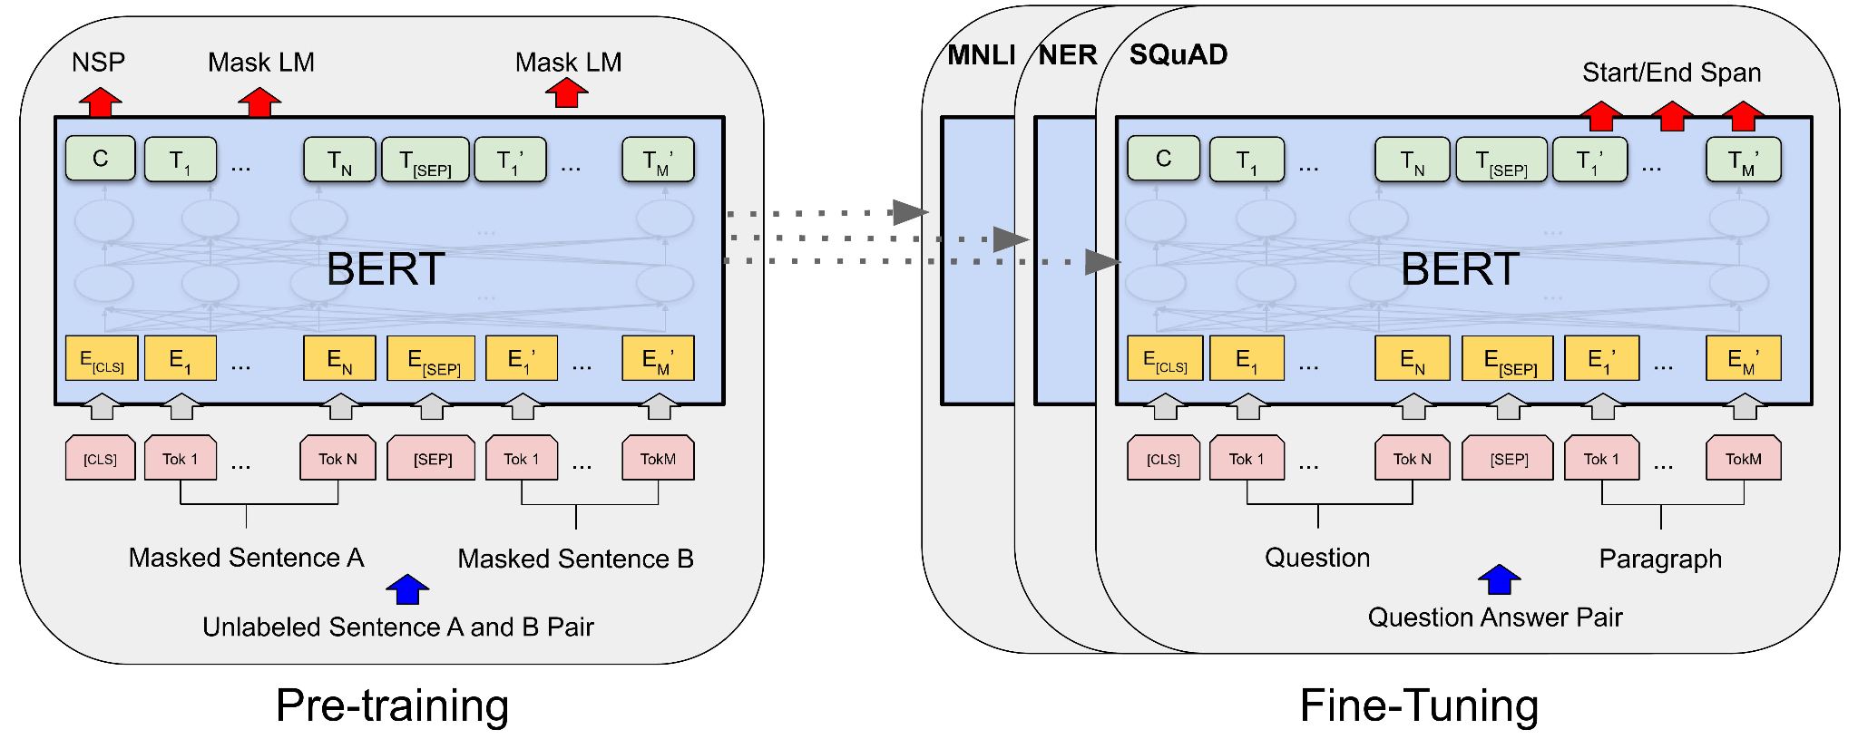
Introduction
We have to create a classifier which would predict that the, given news headline is sarcastic or not.
For that we are using pre trained bert models.These are trained on large corpuses of data which helps them learn the context and then are used for various NLP tasks.
The basic building block of most of the LLM models these days is the Transformer Model, which consist of an encoder and a decoder block.

Slide 3
Challenges in Detecting Sarcasm
Context Dependency: Sarcasm often relies heavily on the context in which it is used. Understanding whether a statement is sarcastic can depend on prior knowledge of the conversation, the relationship between the speaker and the listener,
Figurative Language: Sarcasm is a form of figurative language that often involves irony, understatement, or exaggeration. This means that the literal meaning of the words used does not match the intended meaning, which adds a layer of complexity for algorithms trained primarily on literal text interpretation.
Subtlety and Tone: Sarcasm frequently hinges on subtle cues in tone, which can be incredibly difficult to detect in written text. While humans can sometimes detect sarcastic tone easily in spoken language through vocal inflections, capturing this in text requires sophisticated analysis of linguistic cues that are not always overt, such as punctuation, word choice, or sentence structure.

Slide 4
Literature Survey
We read through a variety of papers to develop context on all the different concepts that would be required for this project.
We started with LSTM and GRU architectures, setting the groundwork for our mini project..
Specific to our task, we also studied the Context aware Sarcasm Detection using BERT and used other pre Trained models for comparing accuracy

Slide 5

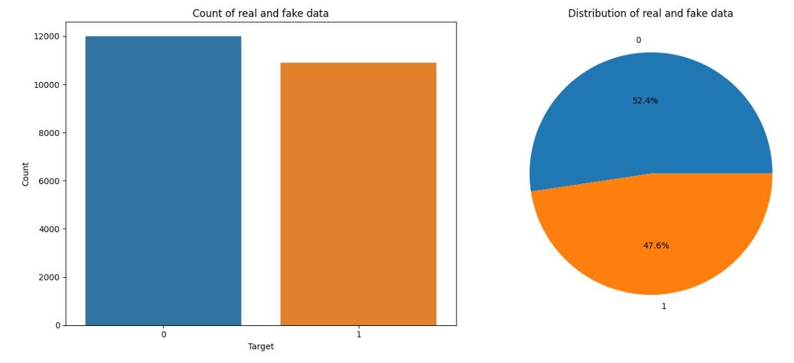
Novel Dataset
We have a training dataset consisting of 22894 rows and 4 columns comprising of ID,Article Link,Text and label
Data has 1449843 different words in combination of all review and ration of sarcastic and non-sarcastic comments are 47.6% and 52.4% respectively.

Slide 6
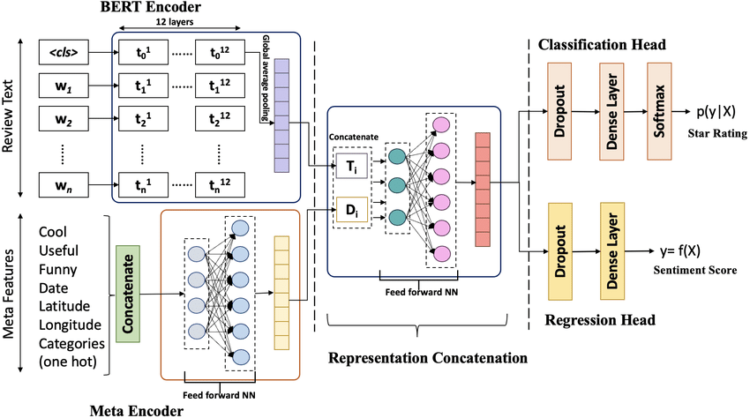
Fine Tuned Architecture
Firstly, embedding layer serves as the entry point for tokenized input data which will be processed by the BERT model.
Then we used a lambda layer to extract the embedding of the first token representing a special classification Token [CLS]
Then use a dense layer with 128 units and relu activation function.
Added a dropout layer with dropout rate of 20%.
Lastly an output layer with single input and sigmoid activation function.

Slide 7
Procedure and Metrics used
The metrics we have used to compare the performance are the basic metrics used for all Q/A performance evaluation which are the Accuracy & F1-Score
We used a cleaning function that first removes punctuations, then special characters, and finally applies the combined stopwords removal and lemmatization.
Then we fine tuned two different models- bert-base-uncased and distill-bert for different hyperparameters

Slide 8
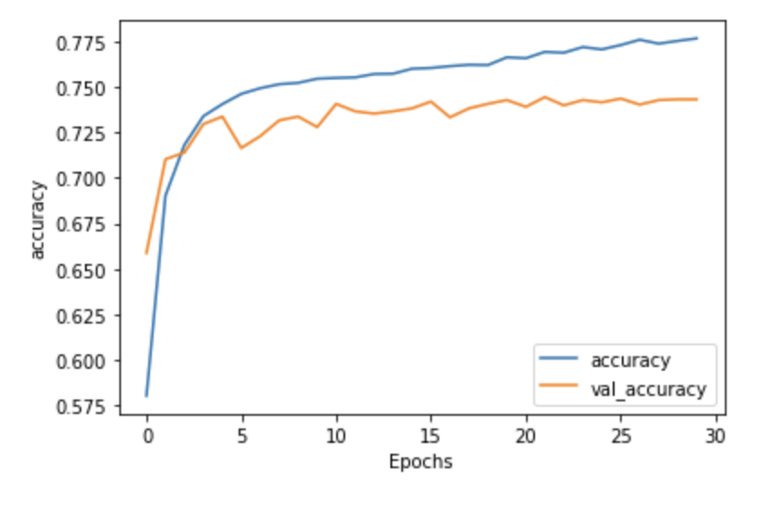
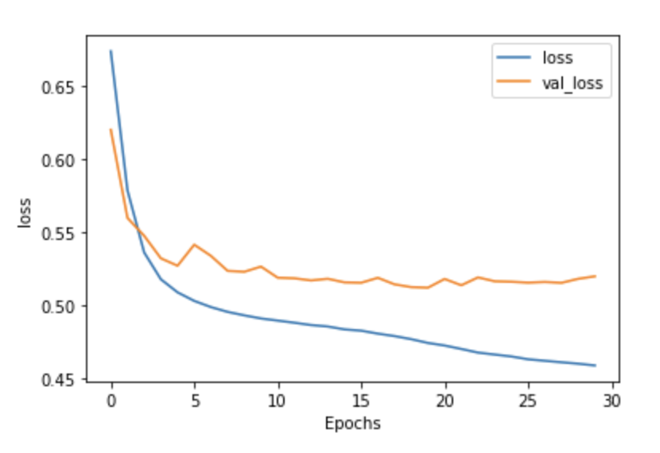
Variation of accuracy and loss with epochs(for GRU architecture)
As we are increasing the epochs the gap between losses and accuracies of train and val lines increases. However as it is not showing downward trend means model is generalizing well and indicating stability of the model with minor overfitting .

Slide 9
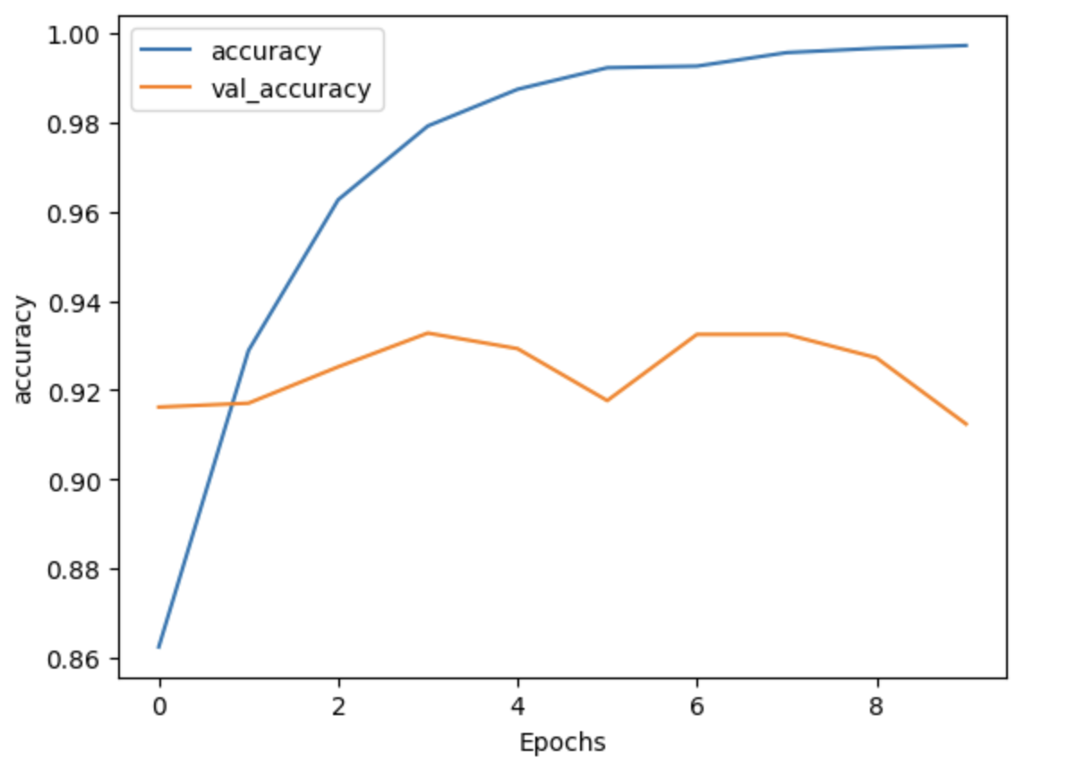
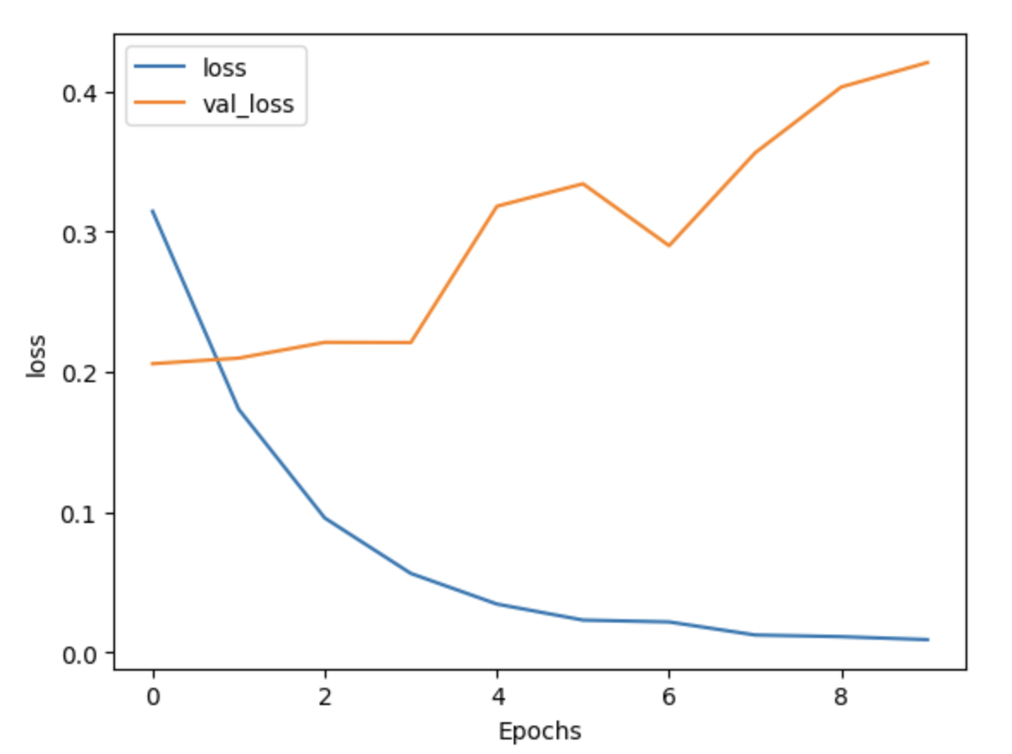
Variation of accuracy and loss with epochs(for bert-base-uncased)
The increase in training accuracy and decrease in training loss at around 2-4 suggests that model is likely to memorize training data after 3 epochs and is not generalizing it.So,we think that 2-3 epochs are enough as validation loss increase after that.

Slide 10
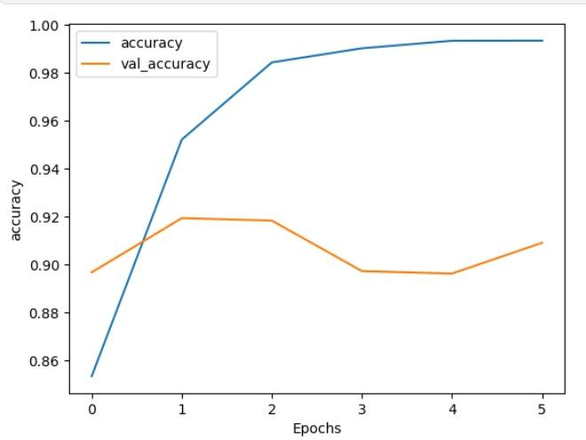
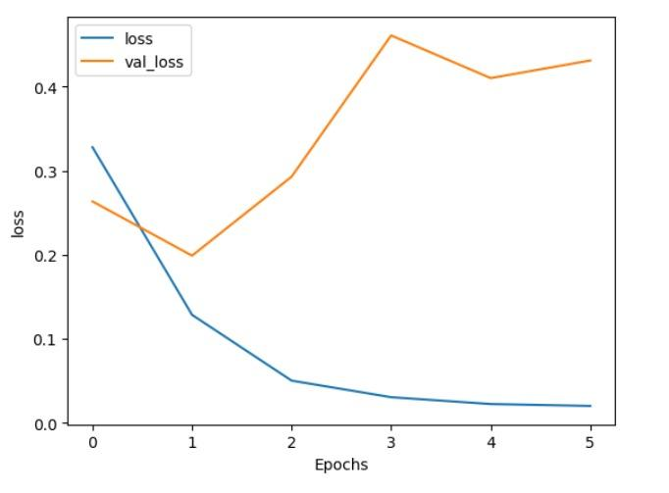
Variation of accuracy and loss with epochs(for DistillBert)
The increase in training accuracy and decrease in training loss at around 1-2 suggests that model is likely to memorize training data after 2 epochs and is not generalizing it.So,we think that 1-2 epochs are enough as validation loss increase after that.

Slide 11
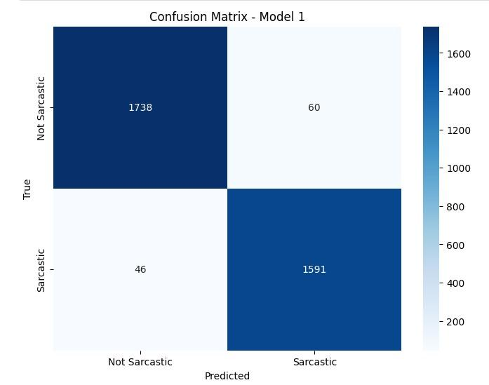
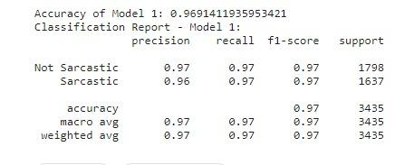
Performance evaluation of bert-base-uncased

Slide 12
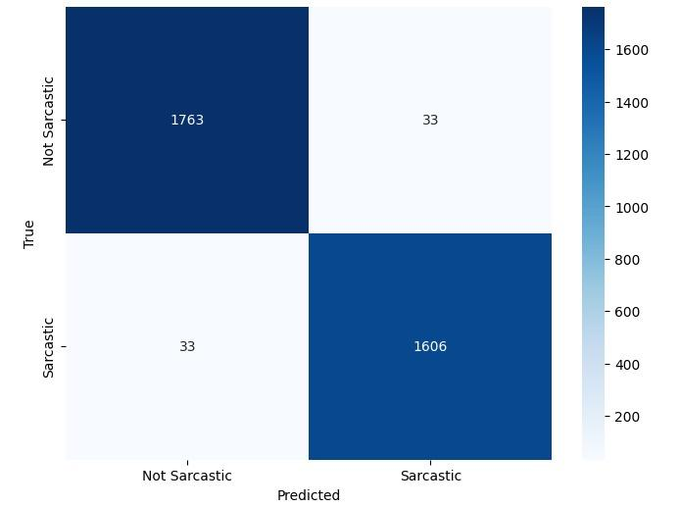
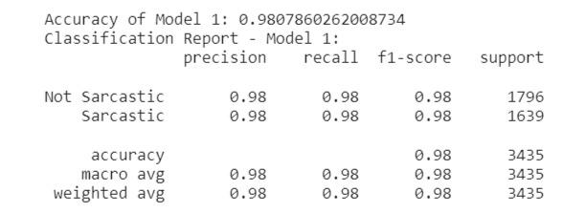
Performance evaluation of distil-bert

Slide 13
THANK YOU!

